Slide 1

OSSLT
Expectations

Slide 2
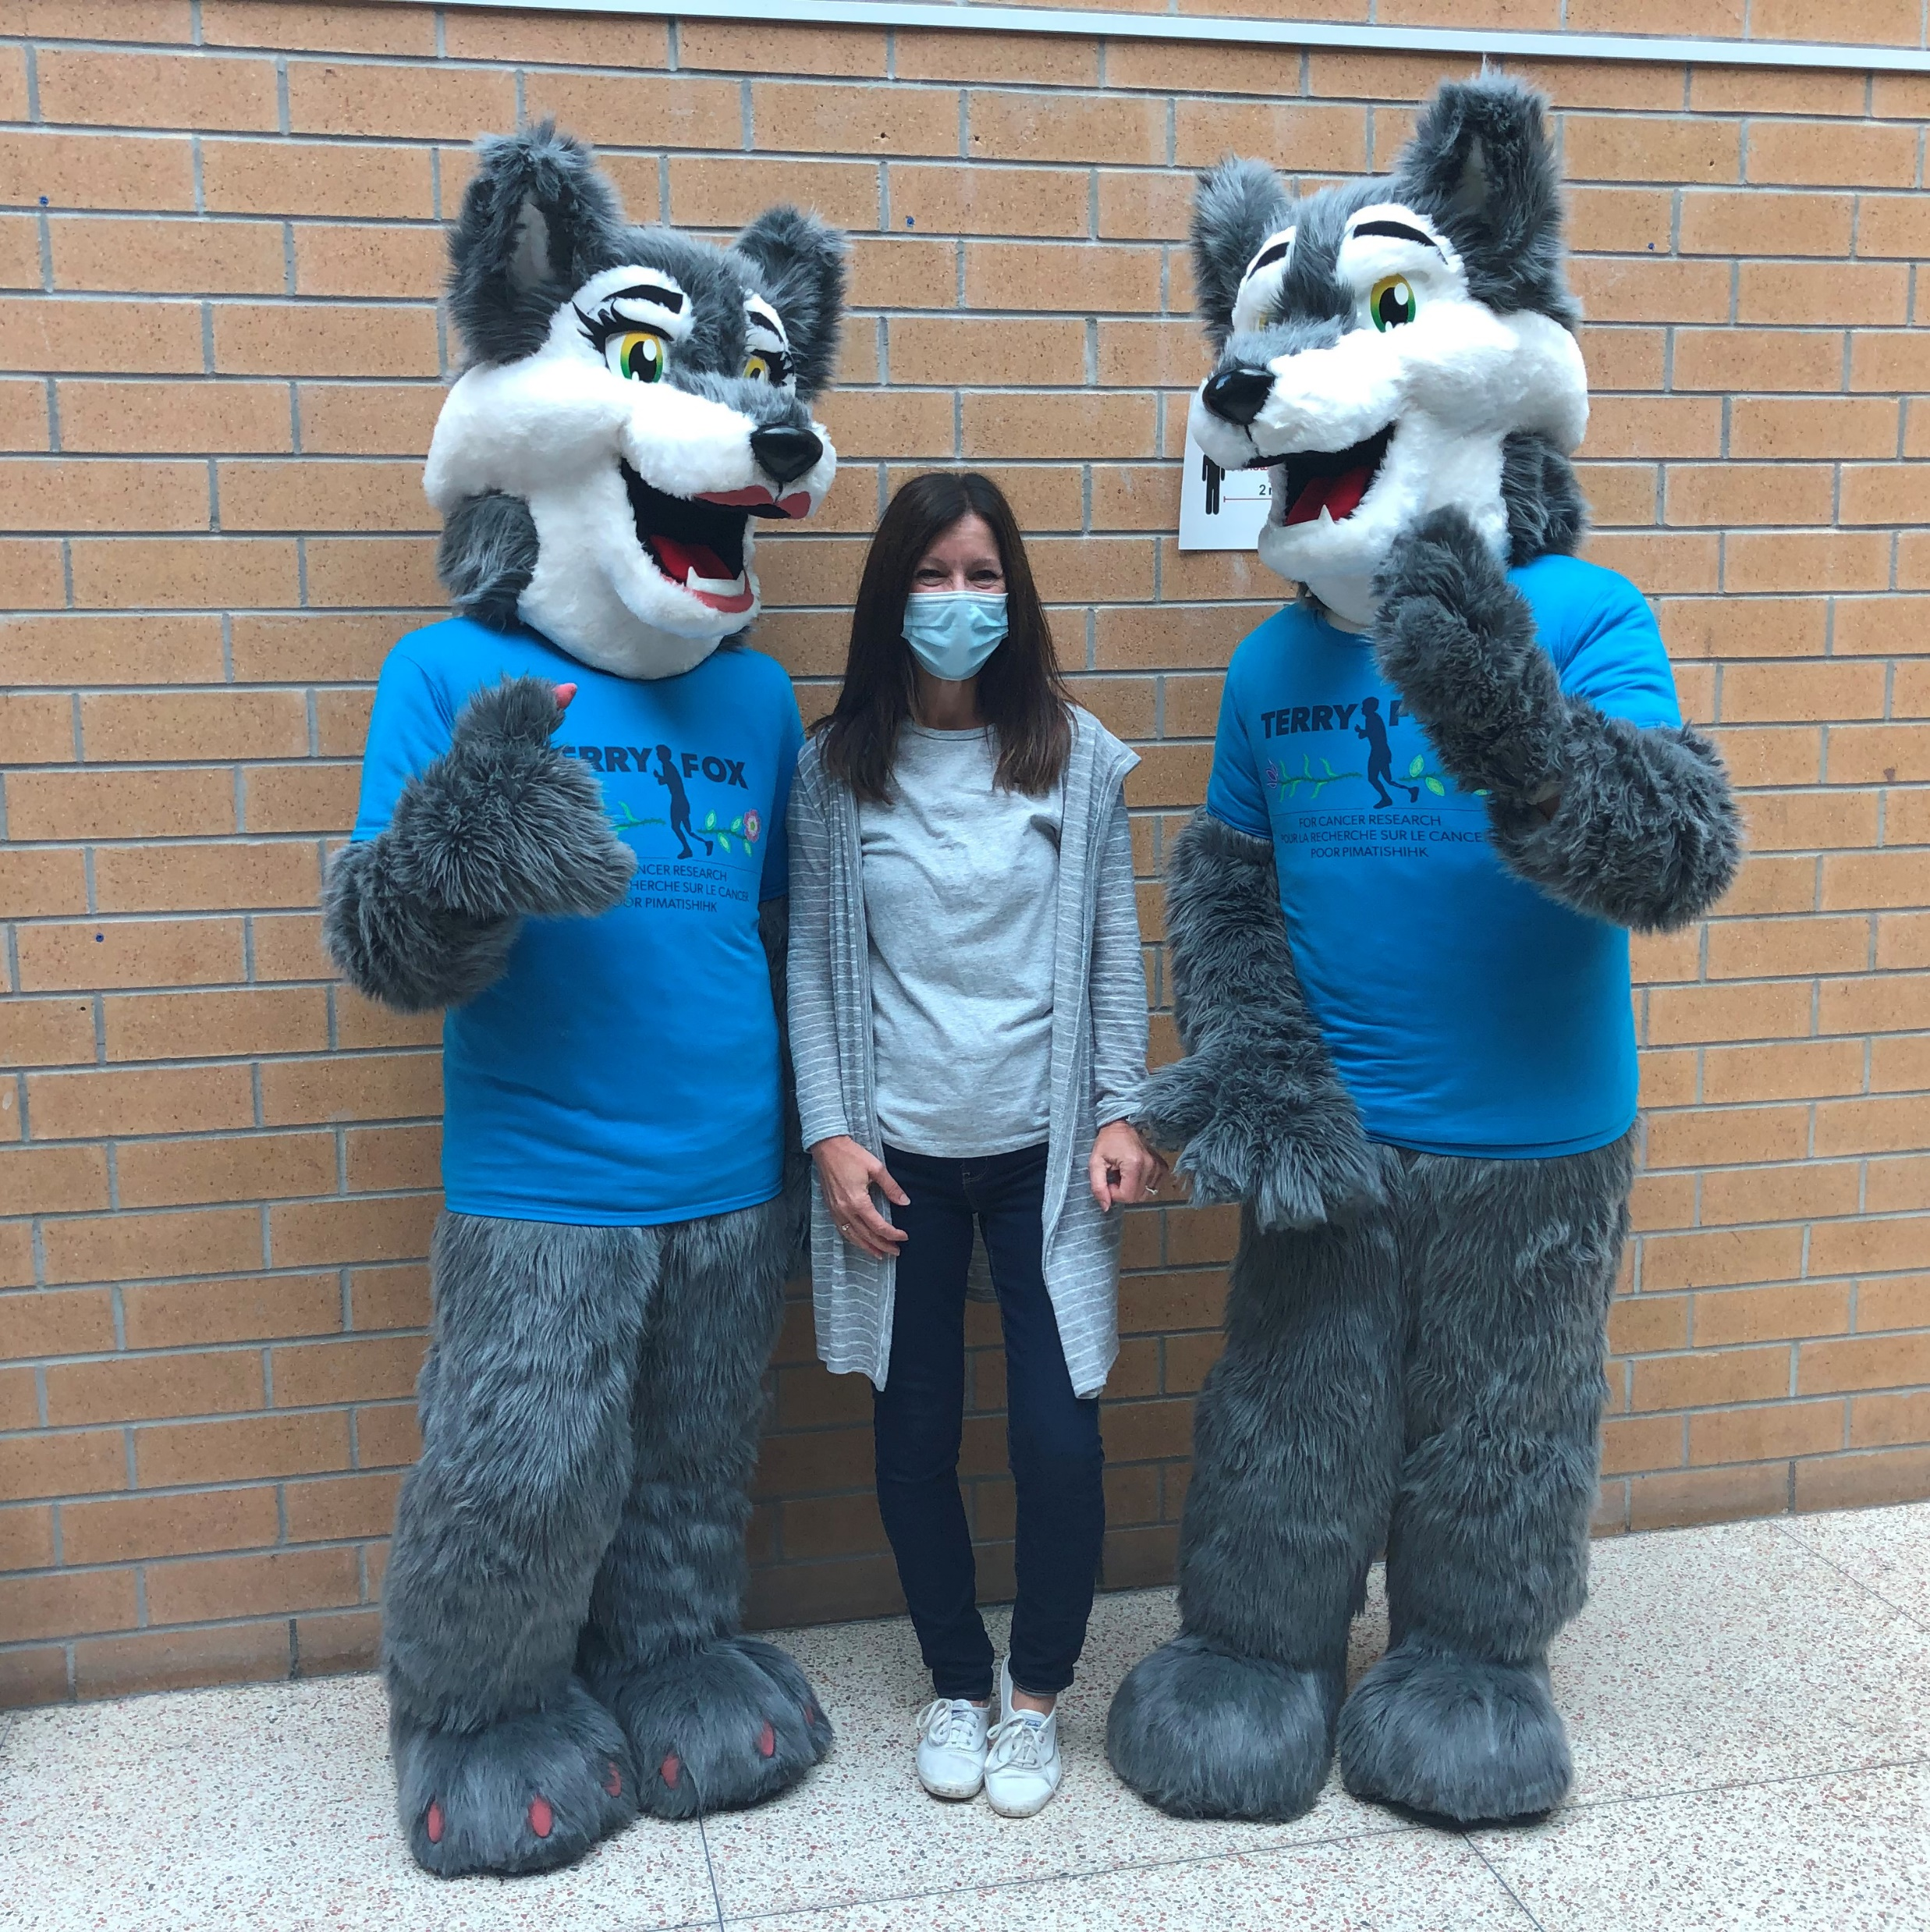
Introduction by Ms. Courtney
Welcome

Slide 3
Who?
ALL Grade 10 students in Ontario MUST write the Ontario Secondary School Literacy Test (OSSLT).
(This year all Grade 11 students wrote in the Fall 2021).

Slide 4
What is the OSSLT?
The Grade 10 Ontario Secondary School Literacy Test is a GRADUATION requirement for all students.

Slide 5


What is the OSSLT?
It is a test of reading and writing skills.
It is based on the curriculum up to the end of Grade
NINE.

Slide 6

Where?
Students will write the OSSLT in the Library.
Classes will be organized by Homeroom.

Slide 7
When is the OSSLT?
Wednesday, April 20th until Friday, May 3rd.
Periods 1 and 2.
Your Homeroom Teacher has your date.

Slide 8
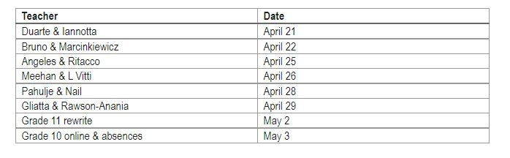

Slide 9
Schedule of the day
Arrival - 8:05
Login/Minds-On - 8:15
Part I - 8:30 until 9:30
Break - 9:30 until 9:40 (snack provided)
Part II - 9:50 until 10:50 (there is also a survey at the end)
Go to Period 3

Slide 10
The 2021/22 difference
This is an Online Test.
It must be completed in person on a Dufferin Peel S.B. computer.
Every student can listen to the test – Bring wired headphones or borrow some from us.
Every student can have as much time as they want/need to complete this test.

Slide 11
What happens if I do not pass the OSSLT?
Students MUST complete a Literacy component in order to GRADUATE.
Students who are NOT successful on the OSSLT this year will take it again in Grade 11 or be scheduled in the Ontario Secondary School Literacy COURSE (OSSLC) in Grade 12.

Slide 12

How?
All students report to the Library first thing in the morning.
You will find your last name and login codes on a computer.
Use of cellphones etc. during the test is prohibited.

Slide 13



How?
All students must be in a full Robert F Hall uniform.
Students will be given a snack. You are welcome to bring a snack or water.
All bags, purses, and coats are to be left in lockers.

Slide 14
What Does The OSSLT Look Like?
The two sessions are presented to students in six groupings of the following types of questions:

Slide 15
Session 1
Real-Life Narrative: a reading selection and seven multiple-select reading questions.
Information Paragraph: a reading selection and six multiple-select reading questions.
News Report: a reading selection, one written response and five multiple-select reading questions.

Slide 16
Session 2
Dialogue: a reading selection and five multiple-select reading questions.
Writing Multiple-Select: eight multiple-select writing questions.
Opinion Essay: one written response composed of a series of paragraphs supporting an opinion.

Slide 17
Some helpful hints
Use headphones to listen to the test.
Use the tools on the right side of the test.
Read the questions before you start reading the selection.
Take your time with this test – Read and Re-read the questions.
Read and Re-read the Reading Selections.
Remember that you are writing for an adult marker.
Flag questions/Proof-read for errors.

Slide 18

Results
OSSLT Results will be released to students in August.

Slide 19
Finally...
Get a good rest the night before the test.
Eat a healthy breakfast the morning of the test.
GOOD LUCK ON THE TEST!

