Slide 1

Applying to College

Slide 2
Do I Have the Credits I Need to Apply?
Check your Student Status Summary
Look For…
Do you have 30 total credits to graduate (add Comp and Elective @ the bottom) + the courses you are taking this year?
Have you covered all the required Compulsory Credits
Do you have the pre-req courses you need for applying to college?
Do you have at least 40 hours of Community Service Hours?

Slide 3
September and October
During the months of September and October you should be doing your research for applying to College.
Go to www.ontariocolleges.ca and research program options.
Make sure you have the appropriate Pre-requisites for the programs you are looking at.
Create a list of possible programs and important information.

Slide 4
www.ontariocolleges.ca
Research!!!
1
Search under “Programs”
2
Search under “Choose a College”
3
Look at the “Highly Competitive Programs”
4

Slide 5
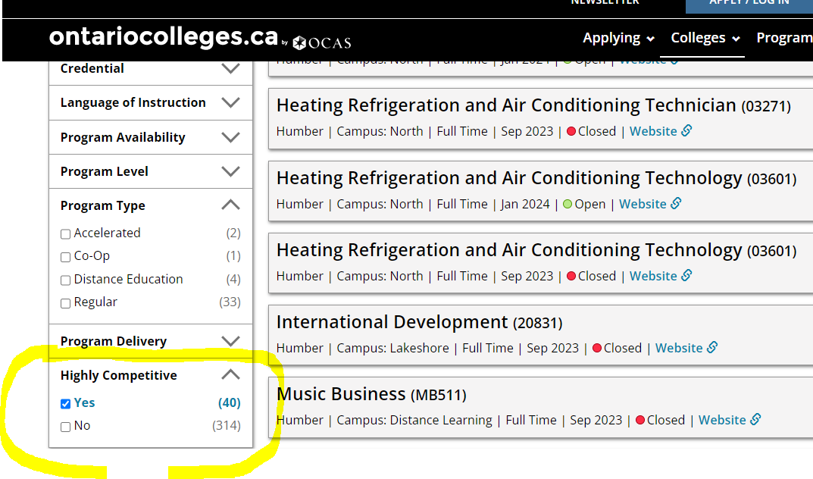
Highly Competitive Programs
These are programs that get many applicants and are harder to get acceptance to.
Each College has a list of their Highly Competitive programs. You can find the list for each College by filtering in the drop down menu.

Slide 6
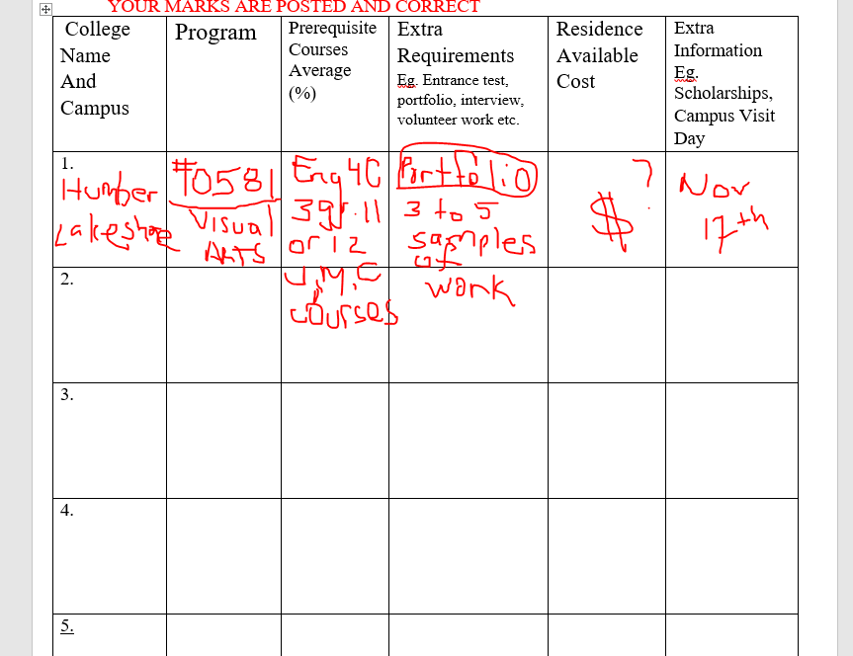
Select 5 Programs – Make a List of Important Info
(no more than 3 program choices at any one college)

Slide 7
Visit College Websites for Virtual/In-Person Tours
https://humber.ca/future-students/tours-events/book-a-tour.html

Slide 8
College FAIR- Attend Fair if Possible
Ontario College Fair
Wednesday October 18th – 5 to 9pm
Thursday October 19th – 9am to 2pm
Enercare Centre CNE ,Toronto
https://ontariocollegefair.ca/

Slide 9

Mid-October Online Applications Open

Slide 10
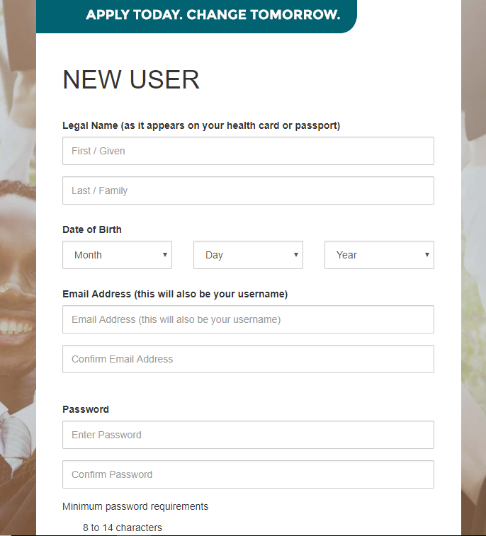
Fill in Personal Information Sections

Slide 11
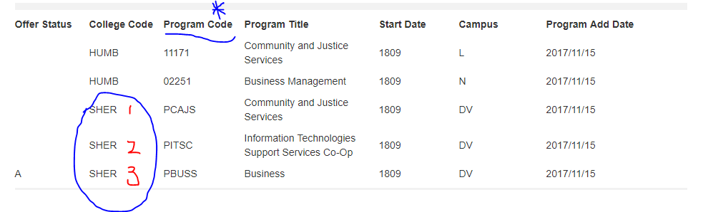
Example

Slide 12

Make Payment $110.00
Your Application will not be processed until you make the payment!
Have your Credit Card ready!

Slide 13
Deadline to Submit
February 1st, 2024
We recommend you submit earlier!!!
When ready with your program choices, complete application.

Slide 14
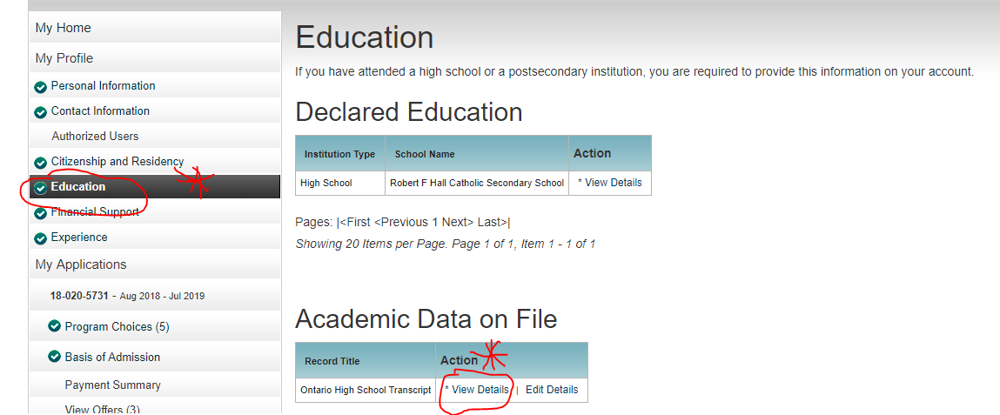
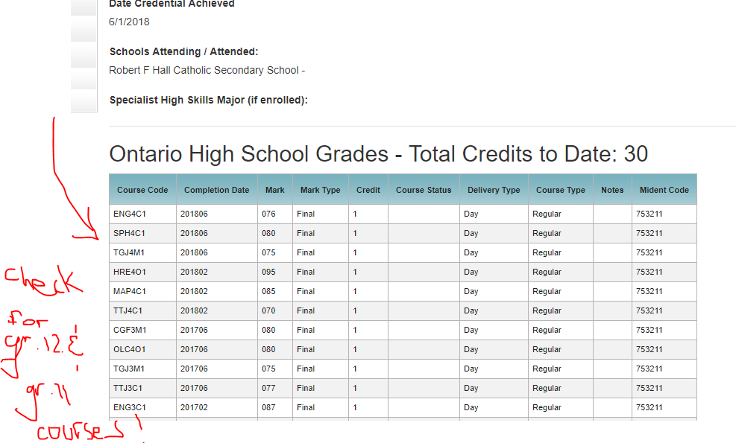
After you Submit- VERY IMPORTANT!!!!
Check your email regularly
After each report card check that your marks are in www.ontariocolleges.ca

Slide 15
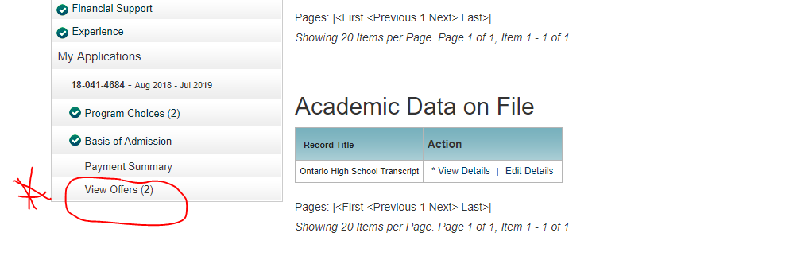
Offers of Admission
Earliest Date that Colleges will send out offers is November 1st, 2023(not for highly competitive programs).
You must accept your offer at www.ontariocolleges.ca

Slide 16
Deadline to Accept an Offer
The most common deadline for confirming offers of admission.
May 1st, 2024
BUT not the only one!!!!
Applicants should check their offers of admission for exact deadline dates.
Once you accept, watch out for tuition deadlines, residence deposits… each school may have different deadlines

Slide 17
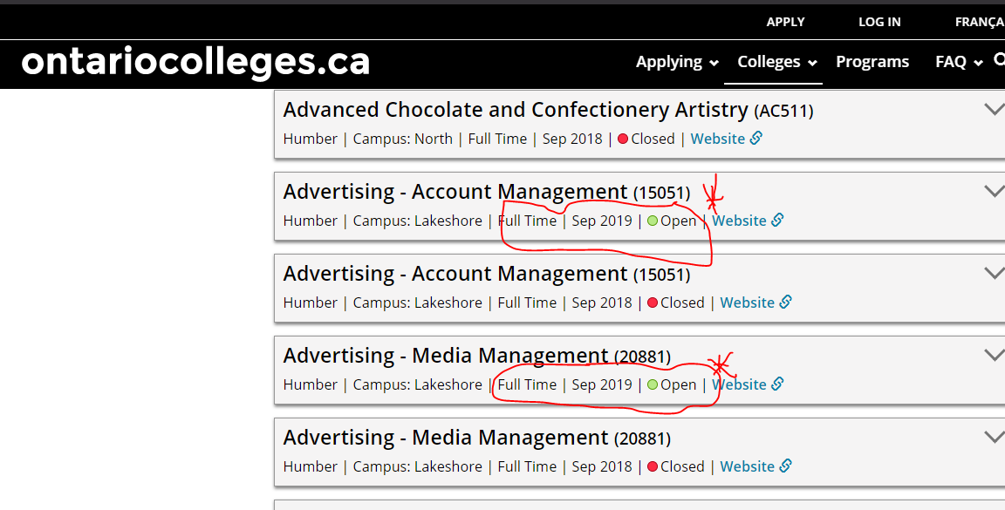
No Offer of Admission
Go back onto www.ontariocolleges.ca
Look for programs that say “open” …you can still apply for these, even in the summer

Slide 18
www.ontransfer.ca
Interested in looking at transfer possibilities to Universities?
Check out each individual college website as well as www.ontransfer.ca

Slide 19
If you have any specific questions, please book an appointment with your guidance counsellor.

