Slide 1

University Application Information

Slide 2
Do I Have the Credits I Need to Apply?
Check your Ontario Student Status Sheet
Look For…
Do you have 30 total credits to graduate (add Comp and Elective @ the bottom) + the courses you are taking this year?
Have you covered all the required Compulsory Credits (see bottom of CCS)?
Do you have at least 6U or M courses, this must include ENG4U?
Do you have at least 40 hours of Community Service Hours?

Slide 3
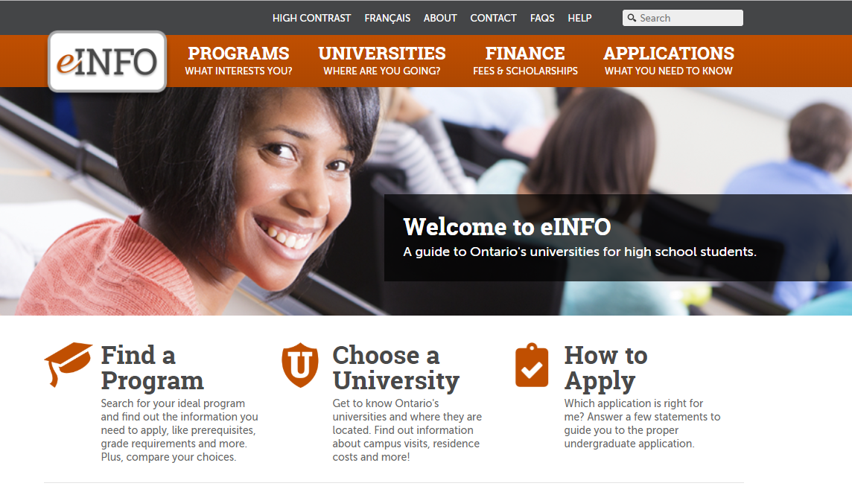
September to November – RESEARCH!!!!
Visit a University Fair – October 20th and October 21st at Metro Toronto Convention Centre
RF Hall Mini Fair – November 14th 1:00pm to 4:00pm
Regional Fairs – Waterloo November 8th 10:00 to 5pm OR Alliston November 16th 10:00 to 5:00pm
Refer to www.ontariouniversitiesinfo.ca

Slide 4
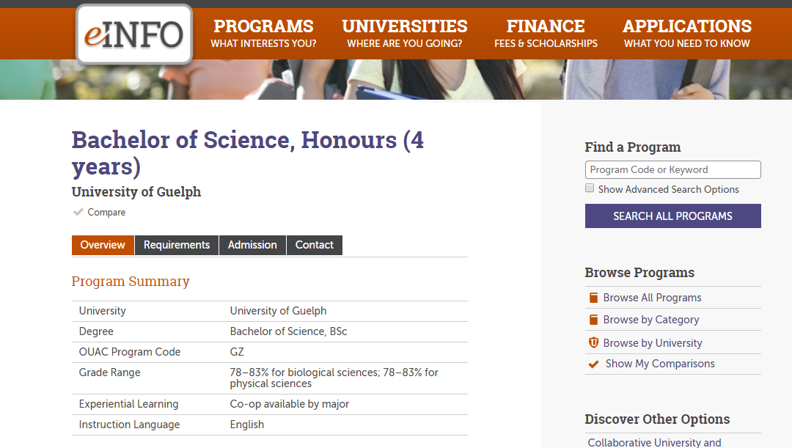

November to December – Applying to University
Make a list of the programs you are interested in applying to.
Note the OUAC program codes

Slide 5

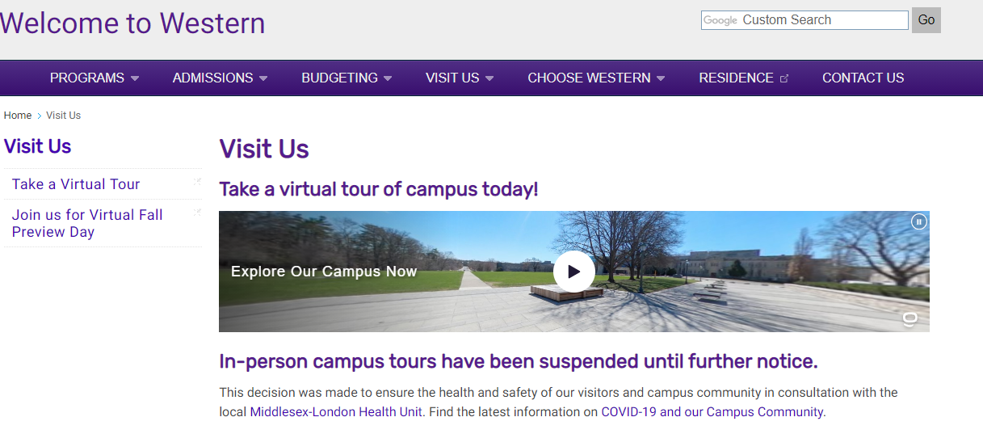
University Websites and Virtual Tours
Check out individual University Websites for more information.
Many are offering pre-taped or live virtual tour options.

Slide 6
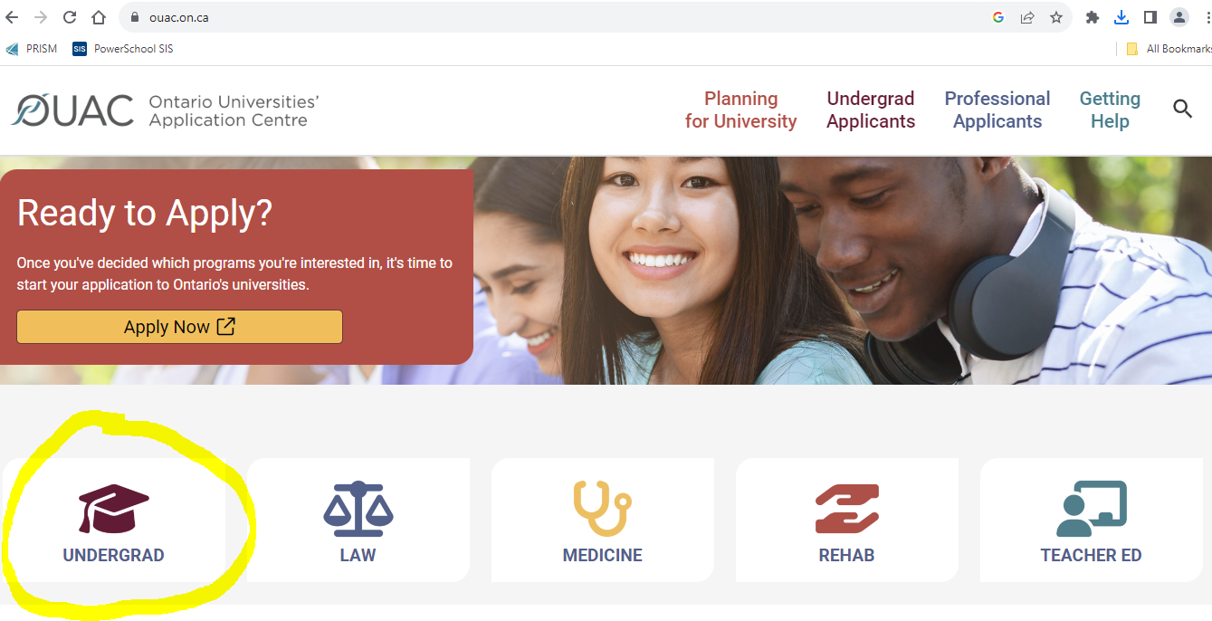
Get to Know the OUAC website www.ouac.on.ca

Slide 7
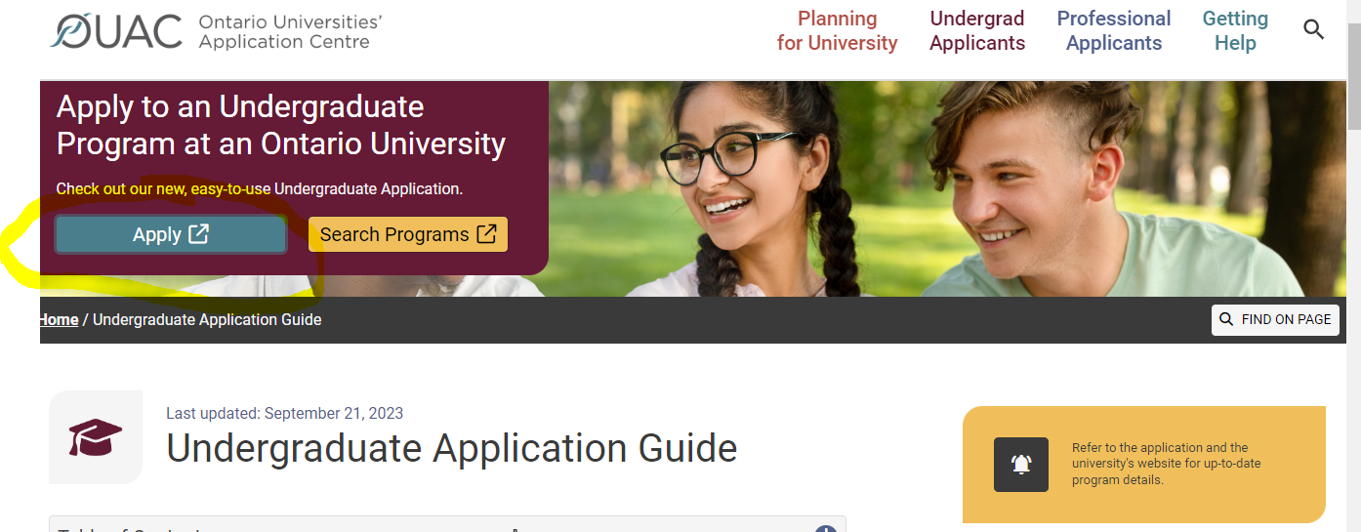
Mid to Late October – Create Account

Slide 8
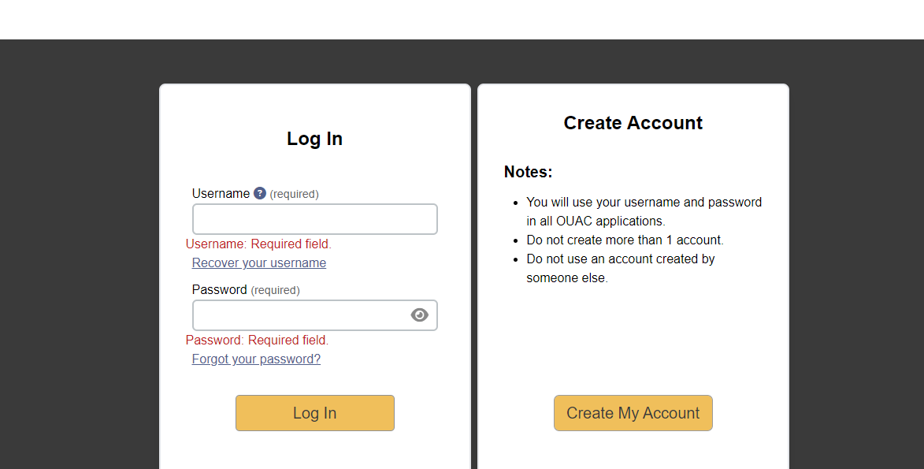
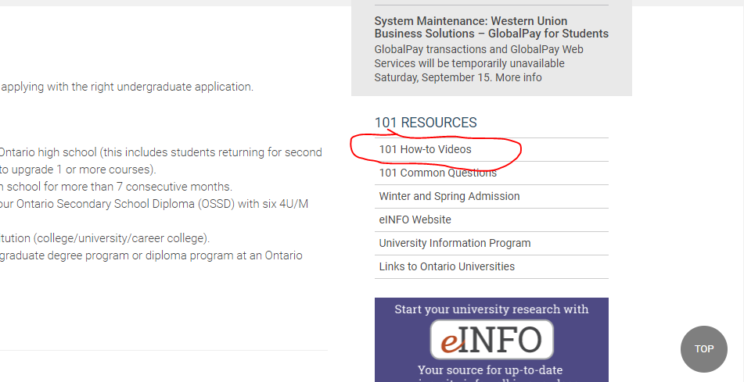
Create Account – Create Only 1 Account!!!

Slide 9
November to December – Applying to University
Apply using you PIN#
Complete all sections of the Application
$150 is the fee for 3 University Programs, additional program choices are $50 each.
You can apply to a MAX of 3 programs at 1 University

Slide 10
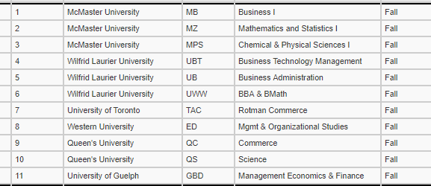
For Example…

Slide 11
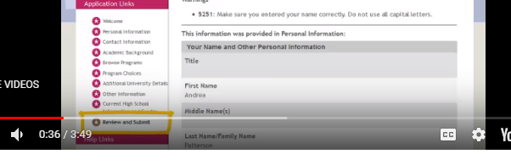
November to December – Applying to University
When you are ready, review your program choices with your Parents then press Review and Submit

Slide 12
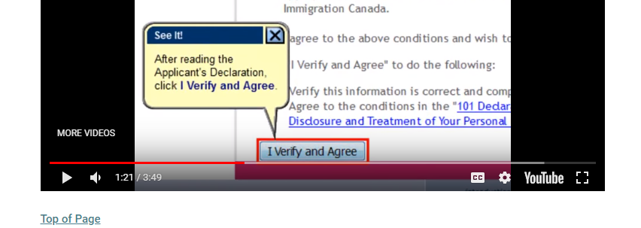
November to December – Applying to University
Verify and Agree
Your Application will not be processed unless you pay. Have your credit card information with you.

Slide 13
Record your OUAC REFERENCE #
This number will be required for future access to your Application

Slide 14
DEADLINE TO APPLY
JANUARY 12th, 2023
We always recommend to apply by the Christmas Holidays

Slide 15
AFTER YOU APPLY
Check your email regularly. Don’t forget to check your Junk email, just in case.
Submit Supplementary Forms/Profiles/Portfolios (If required) by deadline specified by each University.

Slide 16
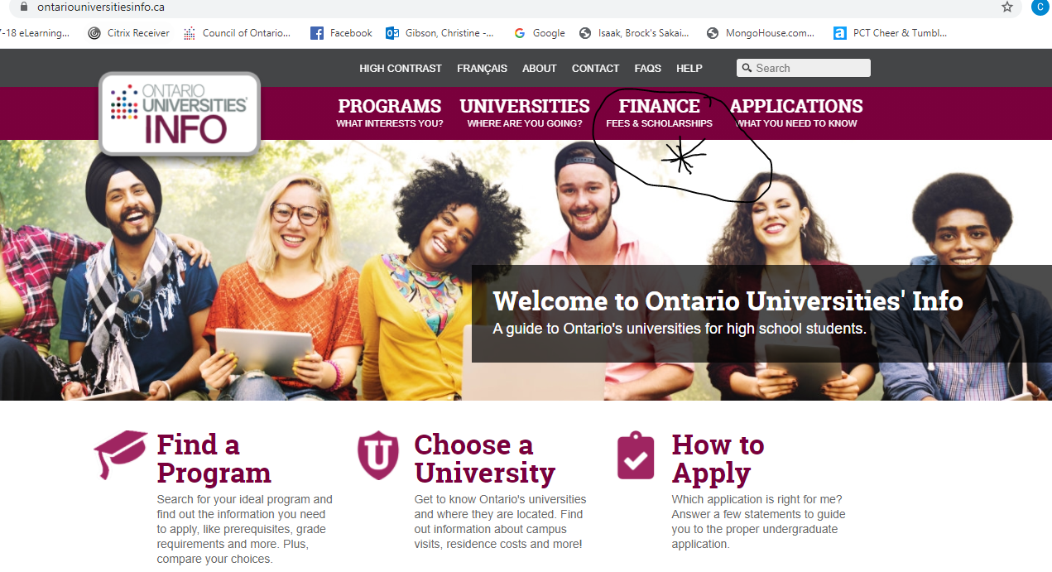
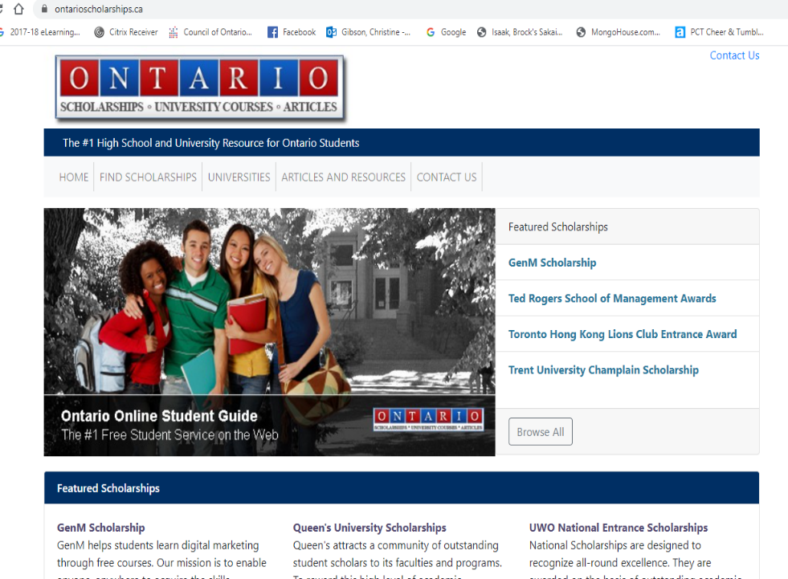
JANUARY and FEBRUARY
Research Scholarships if interested
www.ontariouniversitiesinfo.ca www.ontarioscholarships.ca
Other sources parent’s or student’s workplace

Slide 17
After Each Report Card
******Very Important******
CHECK YOUR MARKS ON YOUR OUAC APPLICATION AFTER EACH REPORT CARD YOU RECEIVE. IF YOUR MARKS ARE MISSING, CONTACT YOUR GUIDANCE COUNSELLOR.
IF YOU ARE TAKING A COURSE AT ANOTHER SCHOOL, IT IS YOUR RESPONSIBILITY TO ENSURE THAT THIS MARK IS ADDED TO OUAC. WE MUST RECEIVE AN OFFICIAL REPORT CARD FROM THIS OTHER INSTITUTION.

Slide 18
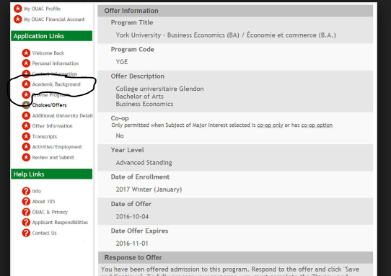
Checking Your Marks

Slide 19
Dropping a Course
You have 5 Days to drop a course after Mid-term report cards so it doesn’t appear on your transcript

Slide 20
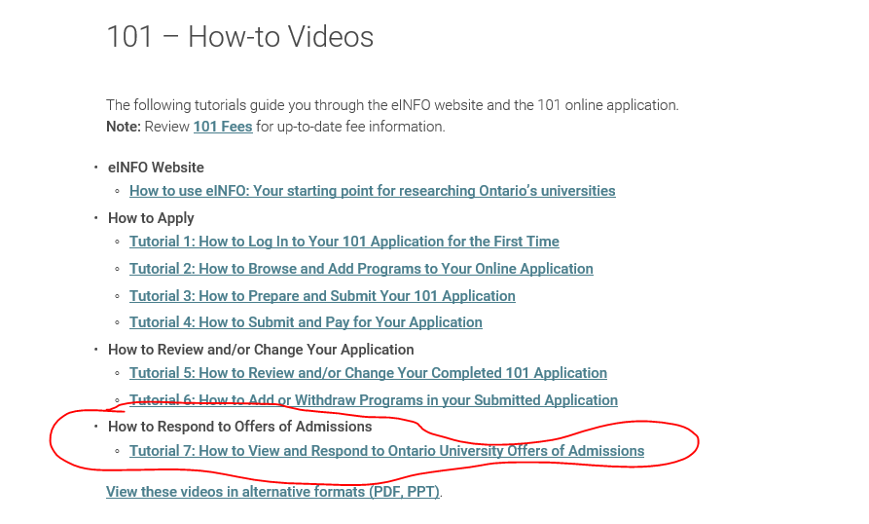
February - May
Offers are sent out, different for all Universities and for different programs
MAY 29th, 2023 – latest day that you will receive a response
Watch the Tutorial “Responding to offers of Admission” @ www.ouac.on.ca/ouac-101

Slide 21
DEADLINE TO ACCEPT an OFFER
JUNE 1st , 2023
Takes at least 24hrs to process – do not accept late!!!
***Remember*** Offers are conditional. You can lose an offer if your final average drops. It is up to you to carefully review your offer and what conditions apply to it.
Make sure you meet the deadlines for tuition and residence deposits. These are different depending on each individual University.

Slide 22
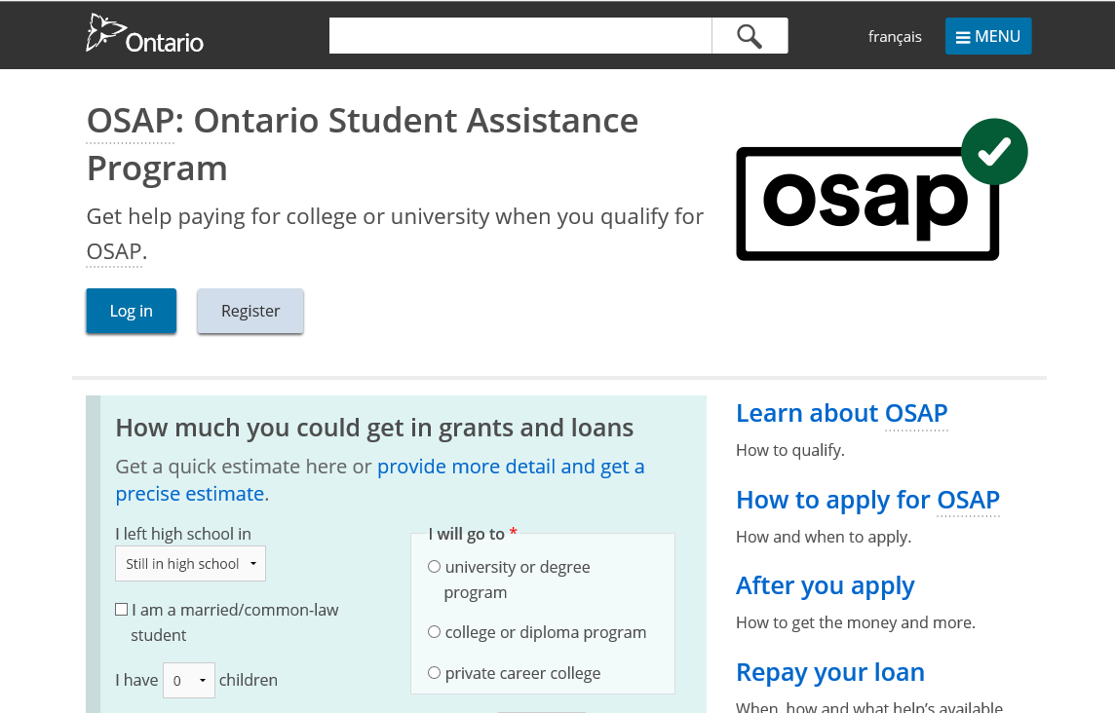
OSAP INFORMATION
Applying for OSAP
www.osap.gov.on.ca
NOTE: You cannot apply until you have accepted an offer.
However, you can begin the application earlier in 2021 and then save it until you are ready to submit.

